Slide 1
History Matriculation
Research Paper

Slide 2
Task List for Monday, September 9th
- Entrance: Grab Exit Ticket and Matriculation Paper Prompt.
- Preparation: Fill out the exit ticket.
- Instruction: What is Matriculation?
- Instruction / Pair Work: What is a Research Paper?
- Exit: Complete Exit Ticket and drop it off in the cluster basket.

Slide 3
What is Matriculation?

Slide 4
What is National History Day?

Slide 5
What does History Matriculation Look Like?

Slide 6
What is Expected

Slide 7
What is Our Schedule?

Slide 8
What is a Research Paper?
A research paper has a topic that is narrow enough to research.
It has a clear thesis statement that answers a question you came up with before you conducted research.
It uses a variety of outside sources and includes direct quotations.
It utilizes a clear organizational strategy.
It uses formal language that is grammatically correct.
It has a Works Cited page listing research sources.

Slide 9
What is a Research Paper?
Individual Work: Highlight key words from each sentence.
Pair Share: Check your table partners paper to see what they highlighted and discuss the difference.

Slide 10
Interests and Topics
An interest is a BROAD category with a lot of different areas of study
A Topic is a NARROW area of study where questions can be asked.
Here are 3 things I enjoy:
History
Education
Astronomy
Are these topics? Or just interests?

Slide 11
Interests and Topics
Here are 3 things I enjoy:
History
Education
Astronomy
How can we make these into topics?

Slide 12
Interests and Topics
Individual Work: In your notes, write down 3 things you enjoy.
Pair Work: Work together with your table partner to narrow down the interests into broad topics.

Slide 13
Task List for Tuesday, September 10th
- Entrance: Grab Exit Ticket and Matriculation Success Criteria.
- Preparation: Fill out the exit ticket.
- Instruction / Pair Work: Choosing a Topic
- Instruction / Pair Work: Narrowing Down a Topic
- Exit: Complete Exit Ticket and drop it off in the cluster basket.

Slide 14
Choosing a Topic
Historical Subfields
Political History –The interactions of the Rulers and the People.
Social History – How everyday life was like.
Military History – Armed conflict and its impact on society.
Economic History – How goods and money flowed in a society.

Slide 15
Choosing a Topic
Historical Subfields
Religious History – The origin and development of religions.
Cultural History – Cultural traditions and the perceptions of historical events
Diplomatic History – The interactions between two societies.
Environmental History – The interaction between a society and its environment.

Slide 16
Choosing a Topic
Historical Subfields
Women’s History – The role of women in a society
Demographic History – The changes of the population of a society.
Rural History – The changes and impact of farms on a society.
Family History – The interactions and changes of a family through history.

Slide 17
Choosing a Topic
Historical Subfields
Ethnic History – The interactions and changes of a people group within a society.
Labor History – The interactions between the Owners of the means of production and the people who sell their labor for wages.
Urban History - The changes and impact of cities on a society.
The History of Education – The way a society instructs its population.

Slide 18
Choosing a Topic
Table Work: Skim over the assigned unit.
When I call on you, be prepared to share:
The essential question for the unit.
2-3 interesting topics from the Unit

Slide 19
Choosing a Topic
Individual Work:
Using the highlighted boxes (one from each box) on the previous page, come up with 8 board topic ideas that interest you.
On the Next Page, Fill out the left column of the Bracket with your topics. Then pick the broad topic that is more interesting to you to move into the next round until you have a winner!

Slide 20
Task List for Wednesday, September 11th
- Entrance: Grab Exit Ticket and Matriculation Success Criteria.
- Preparation: Fill out the exit ticket.
- Instruction / Pair Work: Narrowing Down a Topic
- Individual / Pair / Class Work: Creating a Narrow Topic
- Exit: Complete Exit Ticket and drop it off in the cluster basket.

Slide 21
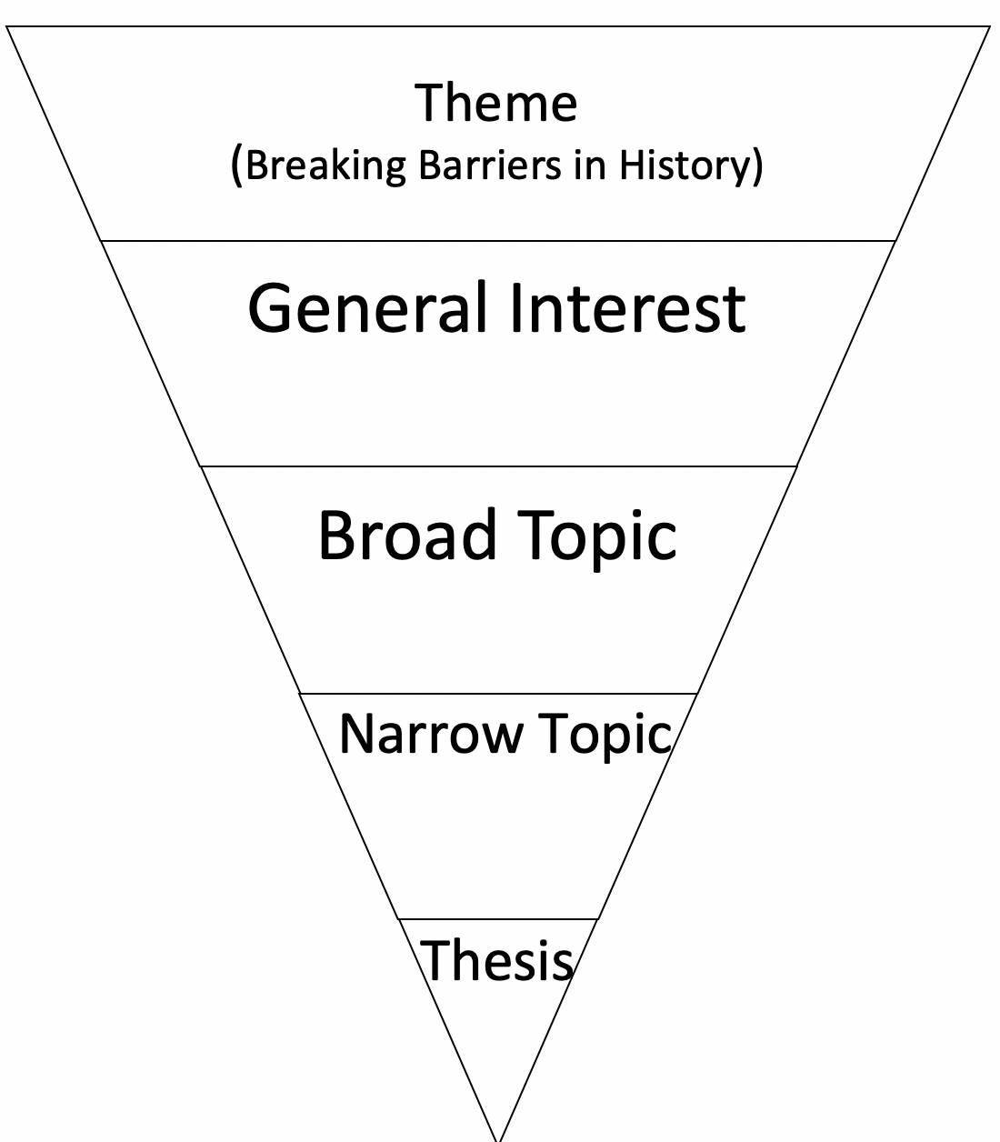
Narrowing Down a Topic
We now need to narrow down your topics.
I am going to walk you through how to do this.

Slide 22
Narrowing Down a Topic
The theme this year is Breaking Barriers in History, Let’s Review:
I have filled in this section for your on Page 8 of your packet

Slide 23
Narrowing Down a Topic
Your general interest will the the time period that you are most interested in.
Write the time period that you are interested in on the second level of the upside down pyramid on page 8.

Slide 24
Narrowing Down a Topic
You then chose a Broad topic from your March Madness.
Please fill this in on the 3rd level of the upside down pyramid on page 8.

Slide 25
Narrowing Down a Topic
Take your Broad Topic and ask yourself the following questions:
Who?
Who is breaking the Barrier? Did they have Allies? Who where the enemies?
What?
What is the Barrier? What kind of Barrier (physical, mental, cultural)?
When?
When was the Barrier being broken? What was happening during this time?
Where?
Where was the Barrier being broken? What was happening in the rest of the country?
Why?
Why was there a Barrier in the first place? Why did it need to be broken?
How?
How was the Barrier broken?

Slide 26
Narrowing Down a Topic
Individual Work: Attempt to come up with a narrow topic IN PENCIL by asking yourself the narrowing questions.
Pair Work: Check each other’s topics to make sure that they are narrow. Initial your partners packet on Page 8 once you think it is narrow enough.
Whole Class Work: Once you are finished, find 3 more people from Different Tables to look at your topic. Get their initials on your narrow topic as well.

Slide 27
Task List for Thursday, September 12th
- Entrance: Grab Exit Ticket and Matriculation Success Criteria.
- Preparation: Fill out the exit ticket.
- Instruction / Pair Work: Narrowing Down a Topic
- Individual Work: Preliminary Research
- Exit: Complete Exit Ticket and drop it off in the cluster basket.

